Slide 1
ENSE374 Activity #1 TEAM O'BRIEN

Slide 2
Team members
Kecheng Yu
Gregory Sveinbjornson
Feras Daghmoush

Slide 3
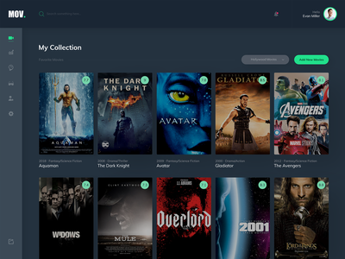
Project idea
Personal Movie Database
Login / Signup webpage
Main page
Personal webpage
List of the subscribed movies
Link to a movie's trailer

Slide 4

Reason/impact
To help user brows and create a personal movie list
To practically apply engineering knowledge we are observing through software courses
To challenge ourselves and be prepared for a potential future Carrer tasks
To have fun and fulfil our interest

Slide 5
Who ?
Who is your audience? Adult Audience
Whose opinion matters? Every user's opinion matters
Who do you want to reach with your work? Students and colleges at this level
Also, know/discuss where your audience is? In the same city
Where do they get their information?

Slide 6
what type of constraints your team envisions?
Manging to complete the puzzle with available time and knowledge.
Manging to build a database and link it to server , and verifying valid emails seems to be challenging

Slide 7
Refrence for the image used in the slides
https://dribbble.com/shots/5769571-Movie-Database-Dashboard

